Slide 1





CUSTOMER BOOKING PREDICTION USING MACHINE LEARNING
Based on Behavioral and Demographic Factors

Slide 2
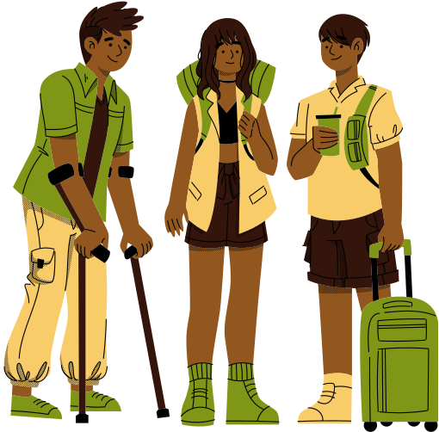
INTRODUCTION
We explored a travel dataset consisting of thousands of booking records to predict whether a customer will complete a booking. This involved cleaning the data, encoding flight-day formats, and building a predictive ML model.

Slide 3


Tools Used
Python
Pandas
matplotlib
Seaborn

Slide 4
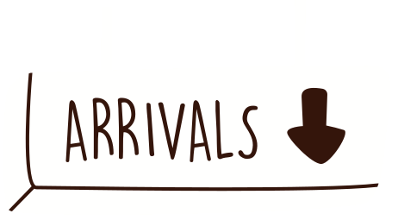

Goal
Predict booking completion and uncover behavioral drivers influencing customer decisions.

Slide 5

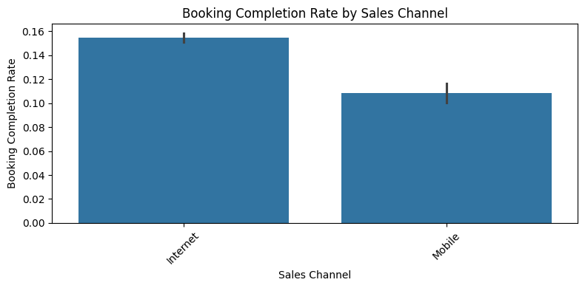
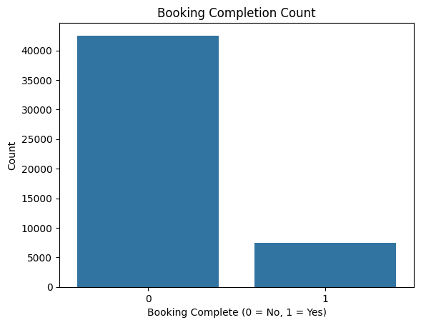
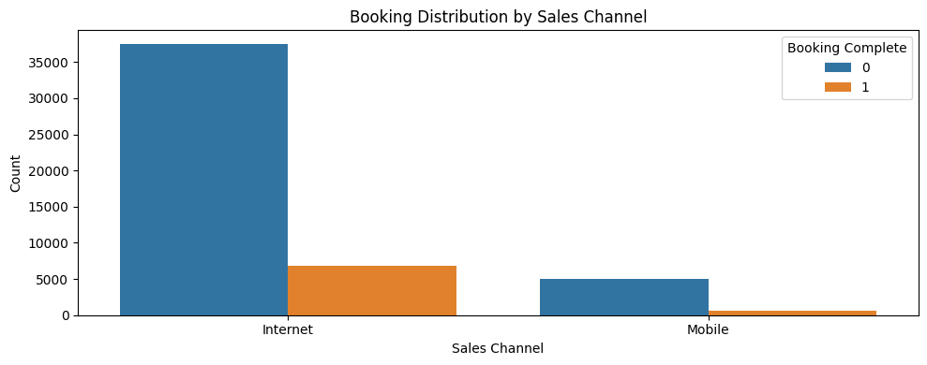
Data Exploration Snapshot

Slide 6
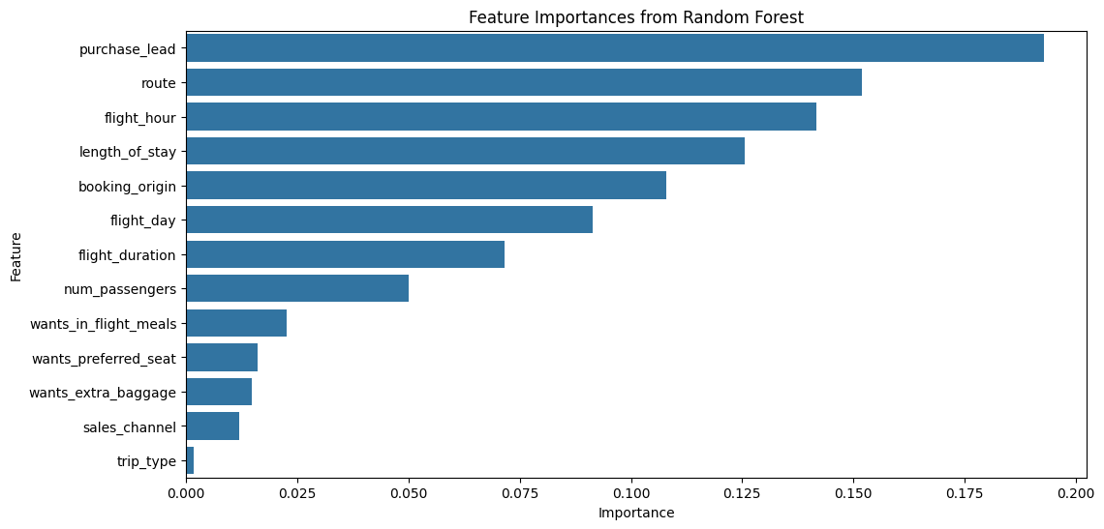
Data Exploration Snapshot

Slide 7

Machine Learning Model: Random Forest
Key Metrics:
Metric | Value
🎯 Accuracy | ~87%
📉 F1 Score | Balanced performance
✅ Best Predictors | Purchase Lead, Wants Extra Baggage, Booking Origin, Flight Duration, Preferred Seat

Slide 8
Actionable Insights & Business Takeaways
Informed strategies can lift conversion rates, improve marketing ROI, and enhance customer personalization.
Offer incentives for long purchase lead customers
Highlight meal/seat preferences to increase booking conversions
Use predicted insights to target high-intent customers with real-time promotions
Consider regional trends (booking_origin) for localized marketing

Slide 9

Thank You
Towards Smarter Travel.
Towards Higher Conversions.
Together.

